Slide 1


Team 50: Remote Biometric System
Bi-Weekly Update 2 Simon Becker
Andrew-Joseph Nicolas
Lance Pagaduan
Harin Sankar Sponsor: Dr. Steven Wright TA: Hailey Ward
Notes:
Michelle

Slide 2
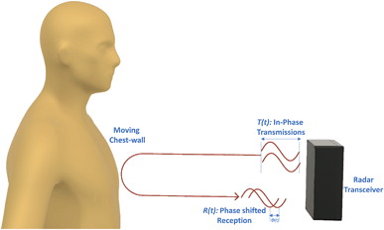
Contactless Cardiac Gating
Extensive and uncomfortable prep can be necessary
MRI Patient throughput can be improved
32% of patients think they wait too long for MRIs¹
Vasireddy, Rakesh & Roth, Corinne & Mathis, Johannes & Goette, Josef & Jacomet, Marcel & Vogt, Andreas. (2018). K-band Doppler radar for contact-less overnight sleep marker assessment: a pilot validation study. Journal of Clinical Monitoring and Computing. 32. 10.1007/s10877-017-0060-9.
Dostál, M., Jurasová, K., Keřkovský, M. et al. What factors affect a patient’s subjective perception of MRI examination. Sci Rep 14, 22731 (2024). https://doi.org/10.1038/s41598-024-74231-9
Notes:
Kyle

Slide 3
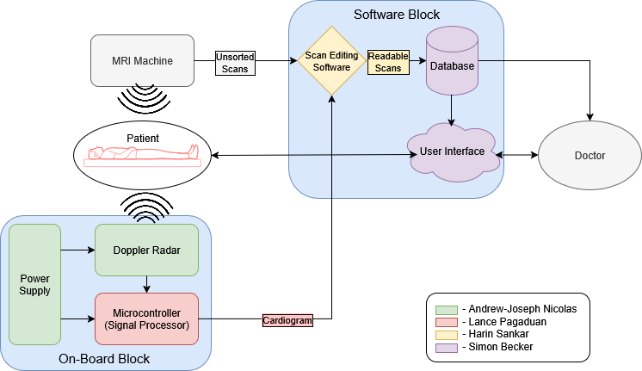
Contactless Cardiac Gating
Notes:
Eric

Slide 4
Project Timeline
Subsystem Designs and Testing (completed 2/2) | PCB Ordered (completed 2/4) | MCU and PCB Integration (to complete by 2/16) | Integration of Scan Filter and Desktop Application (to complete by 2/23) | System Testing (to complete by 3/11) | Validation (to complete by 4/6) | Demo and Report (to complete by 4/19)
Notes:
Eric

Slide 5
PCB
Andrew
Accomplishments since last update 25 hours | Ongoing progress/problems and plans until the next presentation
PCB Ordered Hardware Confirmed | Order supplemental materials Continue configuring radar and DCA

Slide 6
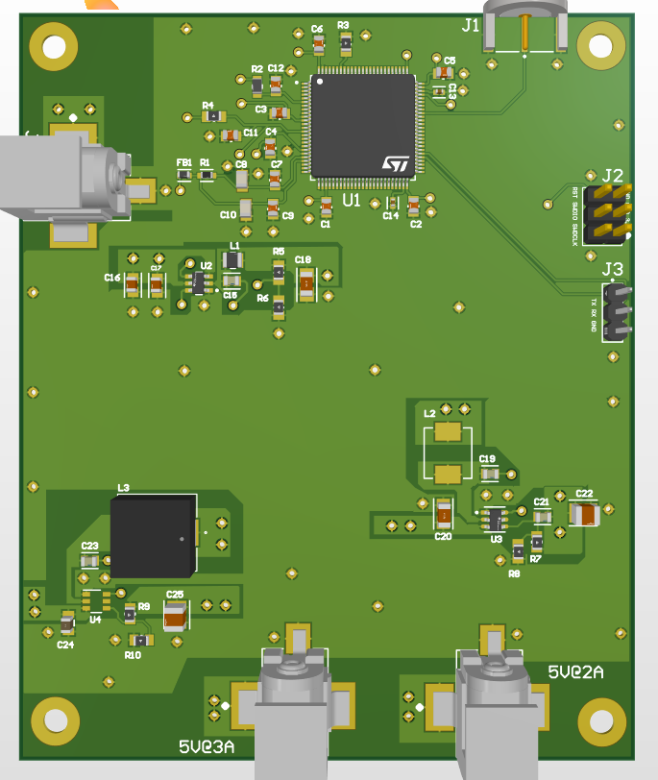
PCB
Andrew
PCB Specifications:
3 Buck ICs:
12 to 5V @ 3A
12 to 5V @ 2A
12 to 3.3V @ 0.5A
MCU:
STM32F407G
BNC Connector
MCU SWD and UART Pinout Headers
Compatible Hardware:
IWR6843AOPEVM
DCA1000EVM

Slide 7
MCU
Lance Pagaduan
Accomplishments since last update 10 hrs of effort | Ongoing progress/problems and plans until the next presentation
Finalized MCU components for PCB integration Flashed the IWR6843AOP Radar with sample vital sign data and verified with reset button for integration with data capture card and MCU | Working on output of vital sign data Configuration of datacard capture for live I/Q values for integration with MCU/PCB

Slide 8
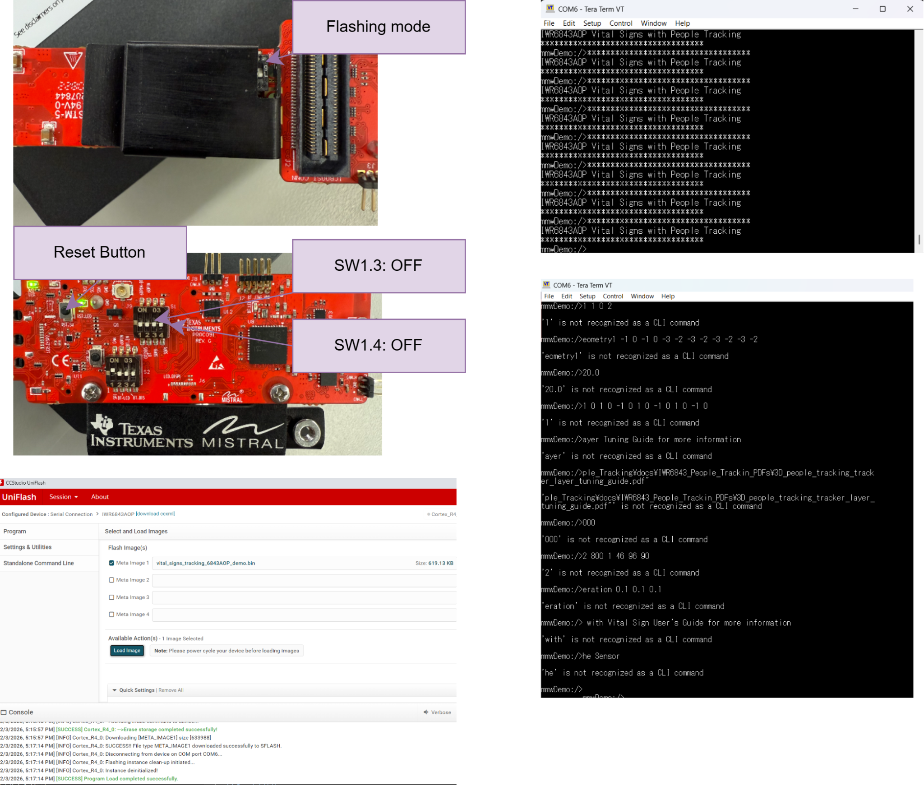
MCU
Lance Pagaduan

Slide 9
Scan Filter Subsystem
Harin Sankar
Accomplishments since last update 15 hrs of effort | Ongoing progress, problems, plans, and goals until the next presentation
Mapped MRI outputs + Python ingest needs for Siemens, MR Solutions, and Esaote. Defined C#-Python integration plan | Implement MRI-filter pipeline so vendor exports are filter-ready. Communicate with Institutional Review Board and Vet School Begin C# UI–Python scan filter integration Plan TTL (prospective) vs retrospective comparison using Esaote

Slide 10
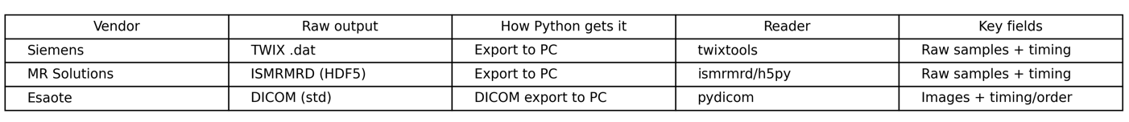
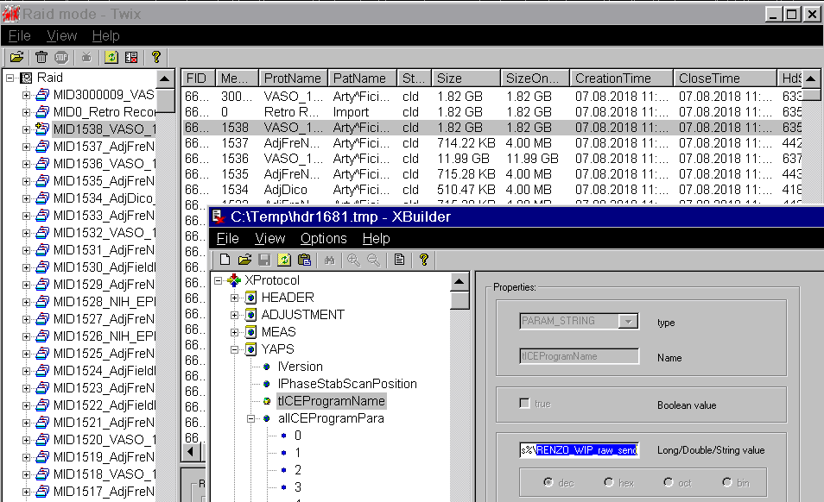
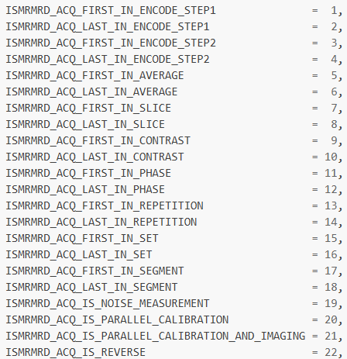
Scan Filter Subsystem
Harin Sankar
Vendor Data Acquisition
Siemens Data
MR Solutions Data

Slide 11
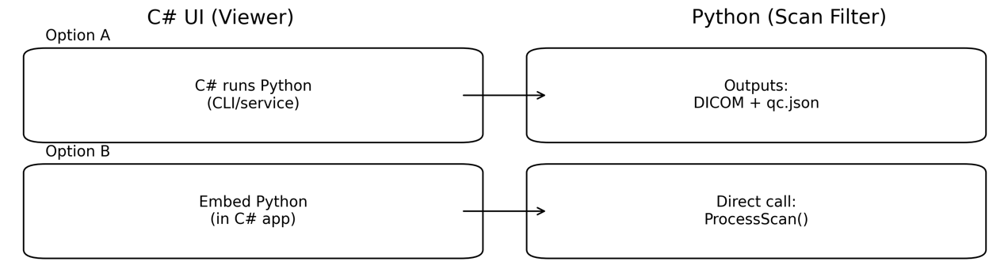
Scan Filter Subsystem
Harin Sankar
Software Integration

Slide 12
User Interface
Simon Becker
Accomplishments since last update 10 hrs of effort | Ongoing progress/problems and plans until the next presentation
Applied built-in DICOM metadata Migrated existing codebase to GitHub | Integrating Scan Filter code with User Interface code

Slide 13
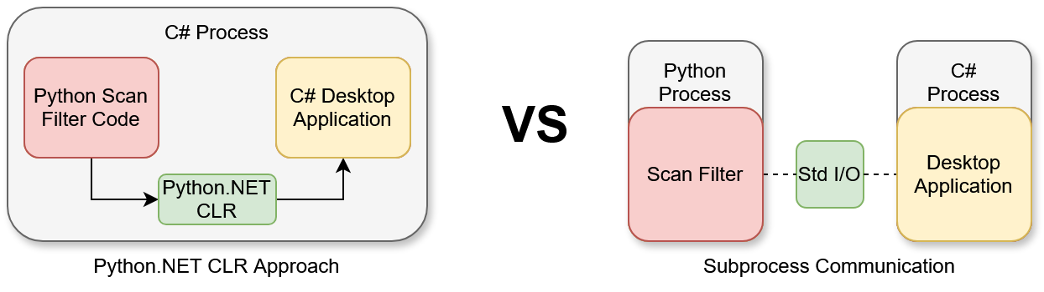
User Interface
Simon Becker

Slide 14
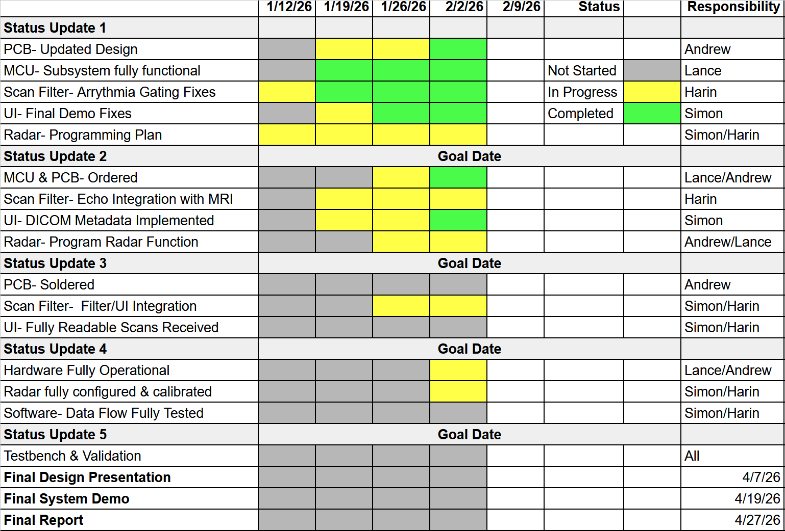
Execution Plan
Notes:
Michelle

Slide 15
THANK YOU

